Slide 1
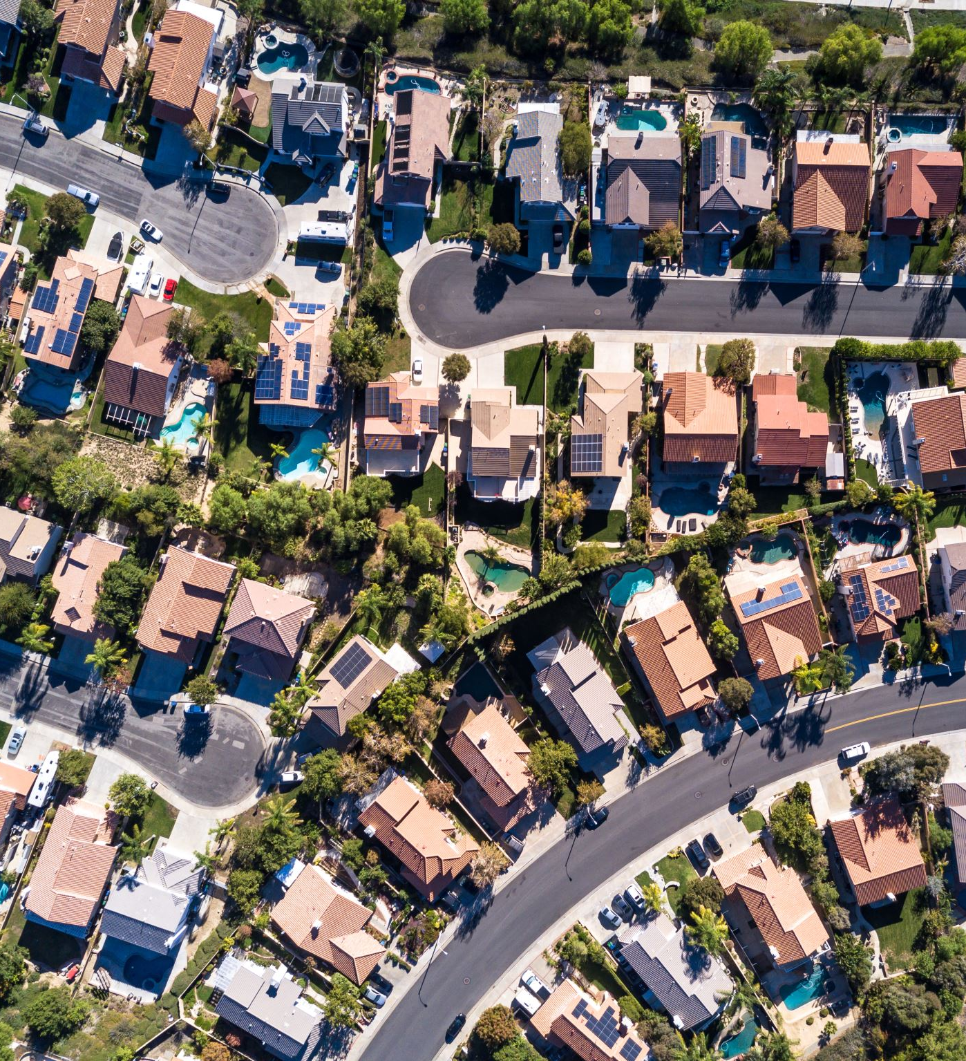
Analysis of San Francisco Housing Market
Exploration of displacement and gentrification phenomena
Pietro Bogani, Tomaso Castellani, Sara Tonazzi

Slide 2




Datasets
Main information:
Neighborhood
Price/mq
Date of the advertisement
# Beds, baths and rooms
Rent: it contains data about online rent advertisements in SF taken from Craiglist. It contains 9779 observations from 2011 to 2018
Address
Neighborhood
Date
Motivation of the eviction
Buyout amount
Evictions&Buyout: it contains the information of the eviction notices and buyout agreements emitted in SF during the period of study. It contains 35931 observations that you can group in 289 observations, if grouped by nhood and year, or 2251 observations if grouped by nhood and month, from 2011 to 2018
Construction: it contains all the permits of construction granted by the city of SF. We extracted the information regarding excusively housing buildings (with an increase of the units) in order to have an idea of the locations of the new houses built in the period of the study. It contains 4226 observations from 2007 to 2018 (also older data are avalaible)
Address
Date (of emission)
Existing and proposed use
Existing and proposed housing units
Latitude and longitude of the vertices of the parcel
# houses for each parcel
Year of construction
Parcels: it contains the coordinates of the residential parcels units in SF.
It contains 114667 observations (i.e. there are 114667 parcels in SF
All the dataset are referred to the period 2007-2018

Slide 3


Goals and research questions
Our main goal is to study the gentrification and displacement phenomena in SF and to provide to the local government precious information about trends in the neighborhoods and measures to tackle the problem. In order to do so, we take into consideration rent prices and eviction notices/buyout agreements as two different measures of displacement and gentrification
How have the housing market prices changed? Are there differences between neighborhoods? What about the number of eviction notices/buyout agreements? Did they change during the past 15 years and how are they distributed across SF?
Increasing the housing supply should mitigate rent increases, but new buildings could also stimulate demand for nearby housing by improving neighborhood quality, which of these two effect is the prevalent one?
Which is the effect of new construction and rent prices on the number of eviction notices/buyout agreements in nearby buildings?
Do the two proxies for displacement/gentrification behave differently to new construction? Do they suggest different policies?

Slide 4
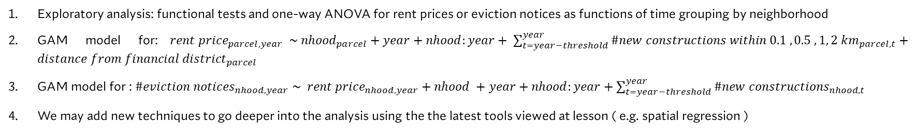
Tentative analytical workflow
Exploratory analysis: functional tests and one-way ANOVA for rent prices or eviction notices as functions of time grouping by neighborhood
GAM model for:${rent price}_{parcel, year} \sim {nhood}_{parcel}+year+nhood:year+ \sum_{t=year−threshold}^{year}{{\#new constructions within 0.1 , 0.5 ,1, 2 km}_{parcel,t}}+{distance from financial district}_{parcel}$
GAM model for : ${\#eviction notices}_{nhood,year} \sim {rent price}_{nhood,year}+nhood +year+nhood:year+\sum_{t=year−threshold}^{year}{{\#new constructions}_{nhood,t}}$
We may add new techniques to go deeper into the analysis using the the latest tools viewed at lesson ( e.g. spatial regression )
For point 2 we are planning to:
Compute the average rent price for each neighborhood for each year
Compute an «interpolated» price for each parcel and for each year as the average (weighted on the distance) of the average rent prices of the neighborhoods (the distance to be weighted on is the one between the centroid of the parcel and the centroid of the neighborhoods)
Compute the number of recent constructions for each parcel and for each year within a 0.1, 0.5 , 1, 2 km radius from the parcel itself (these four values are tentative and may be changed)
Threshold: past constructions have an effect for several years on nearby rents. We’ll set the threshold by trying with more than one value looking for the most significant one
Build the final GAM model and analyze the results, looking in the particular at the relationship between rent prices and new construction
For point 3 we are planning to:
Compute the number of eviction notices for each neighborhood and for each year
Compute the number of new constructions in each neighborhood for each year (to do so, we are building a function to pass from «address level» to «neighborhood level» of the constructions)
Threshold: past constructions have an effect for several years on nearby rents. . We’ll set the threshold by trying with more than one value looking for the most significant one
Build the GAM model and analyze the results, looking in the particular at the relationship between rent prices & new construction and eviction notices

